Slide 1

The Talking Mailbox
LoRa-WAN Post Detection System
By Abhinav Kothari (33349) and Justin Chin Cheong (34140)

Slide 2

Problem
Professors/Instructors have a lot to do, and don’t always have the time to see the mailbox
Checking for mailbox and finding nothing can be annoying and a waste of time
Posts can remain unchecked for a long time if professor is busy
No way of knowing if post received if away (e.g., on conference/vacation)

Slide 3

Requirements
Detect mailbox opening
Detect mail status (no mail, light or heavy mail)
Communicate mail status remotely

Slide 4
Outline
Existing Products
System Design and Process
Results
Potential Improvements

Slide 5

Existing Products
A Review of Products on the Market

Slide 6

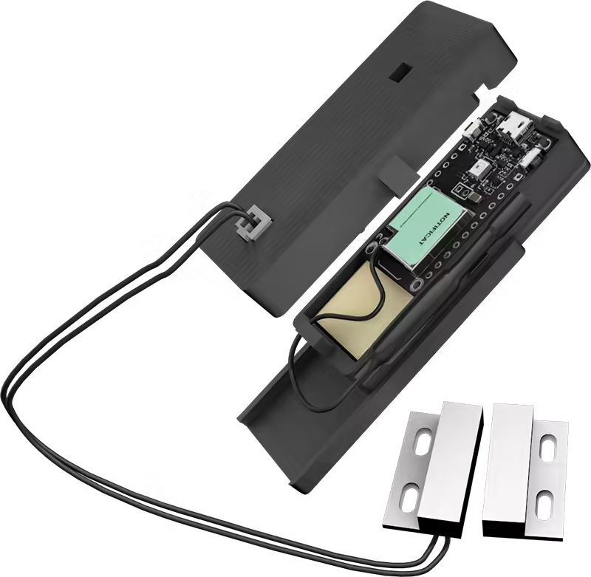
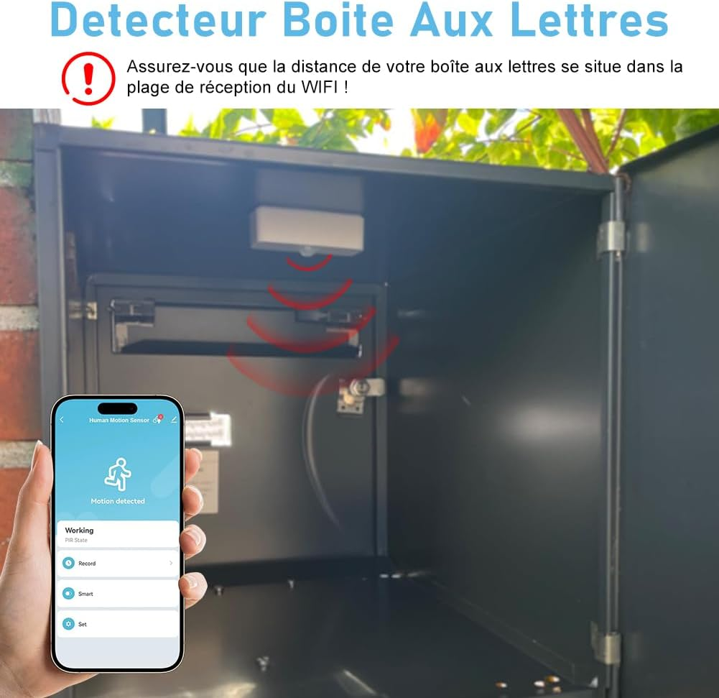
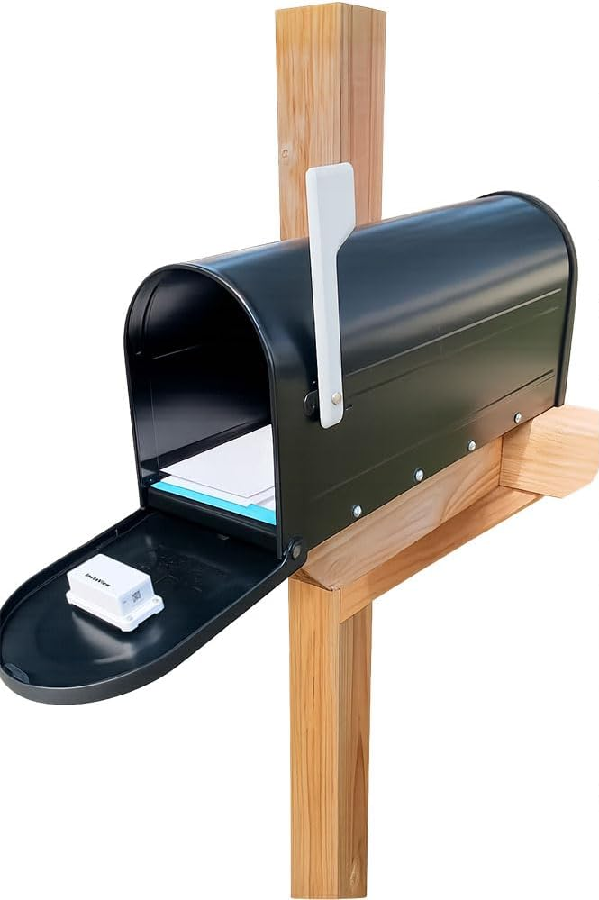
Existing Products
Notific-at
Fouvin
InstaView
X-Sense

Slide 7

System Design
Design, Process, Issues and Solutions

Slide 8
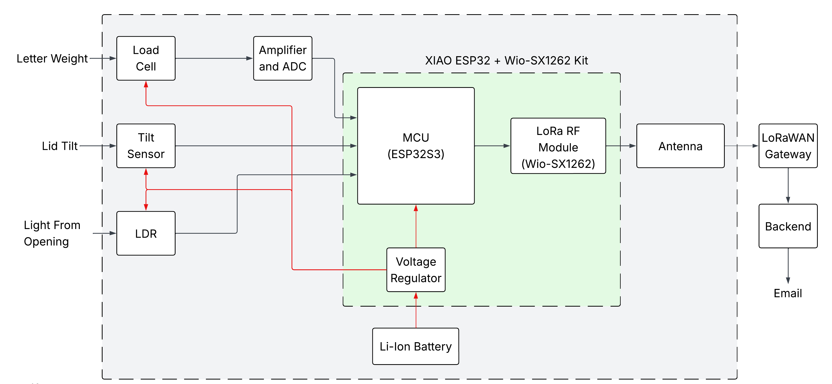
System Architecture
Notes:
Use a weight sensor to detect if a post comes in

Slide 9
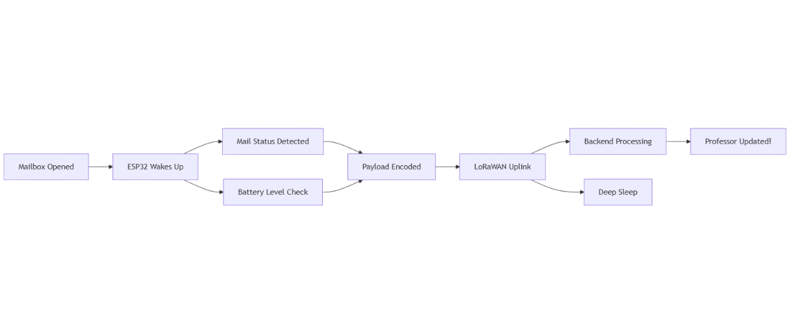
System Flowchart
Notes:
Use a weight sensor to detect if a post comes in

Slide 10
Bill of Materials
Component | Description | Price [EUR]
Weight Sensor | JOY-IT Load Cell + HX711 | 6.40
Digital Tilt Switch | IDUINO Ball Tilt Switch | 0.94
Digital Light Sensor | Sertronics LDR | 1.35
MCU + LoRa Module | Seeedstudio Xiao ESP32 + Wio SX1262 | 11.68
Antenna | Amphenol 868MHz long range | 2.69
Battery | SOLDERED 1800mAh Li-Ion Pouch | 10.24
Housing | Load Cell platform | 11.50
Misc. Electronics | Wires, Resistors, Breadboard, etc | 1.00
Total (+ 20% VAT) |  | 54.96

Slide 11
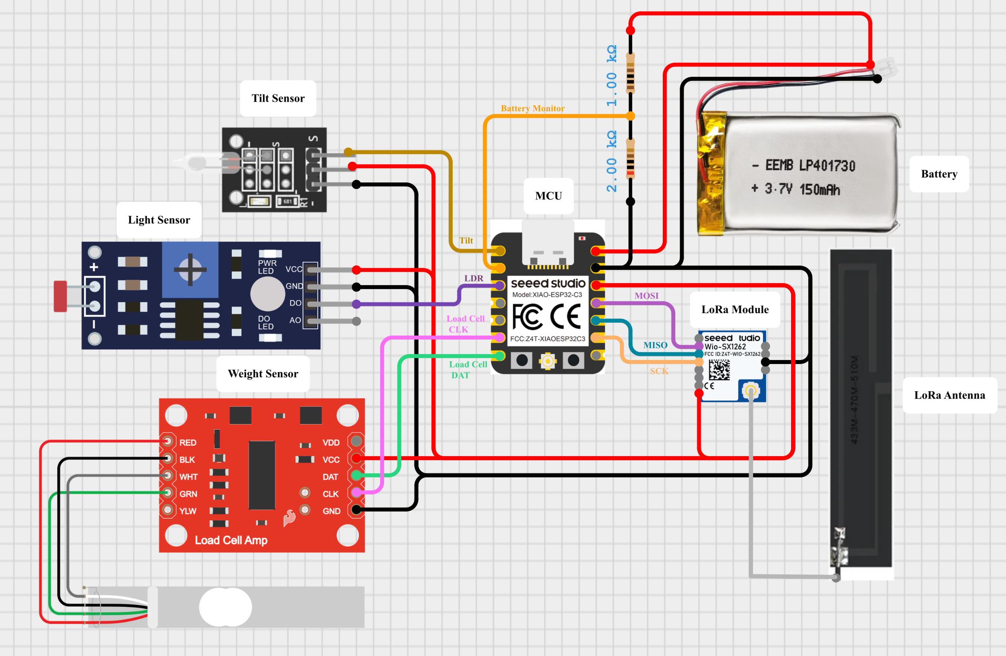
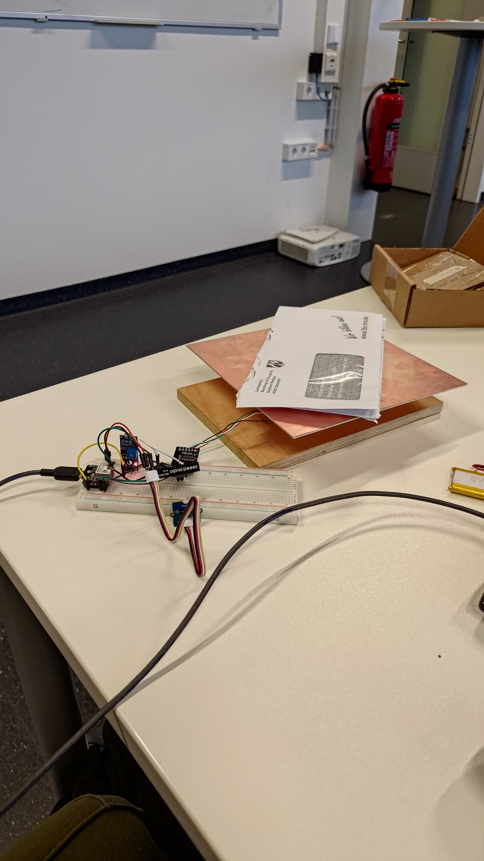
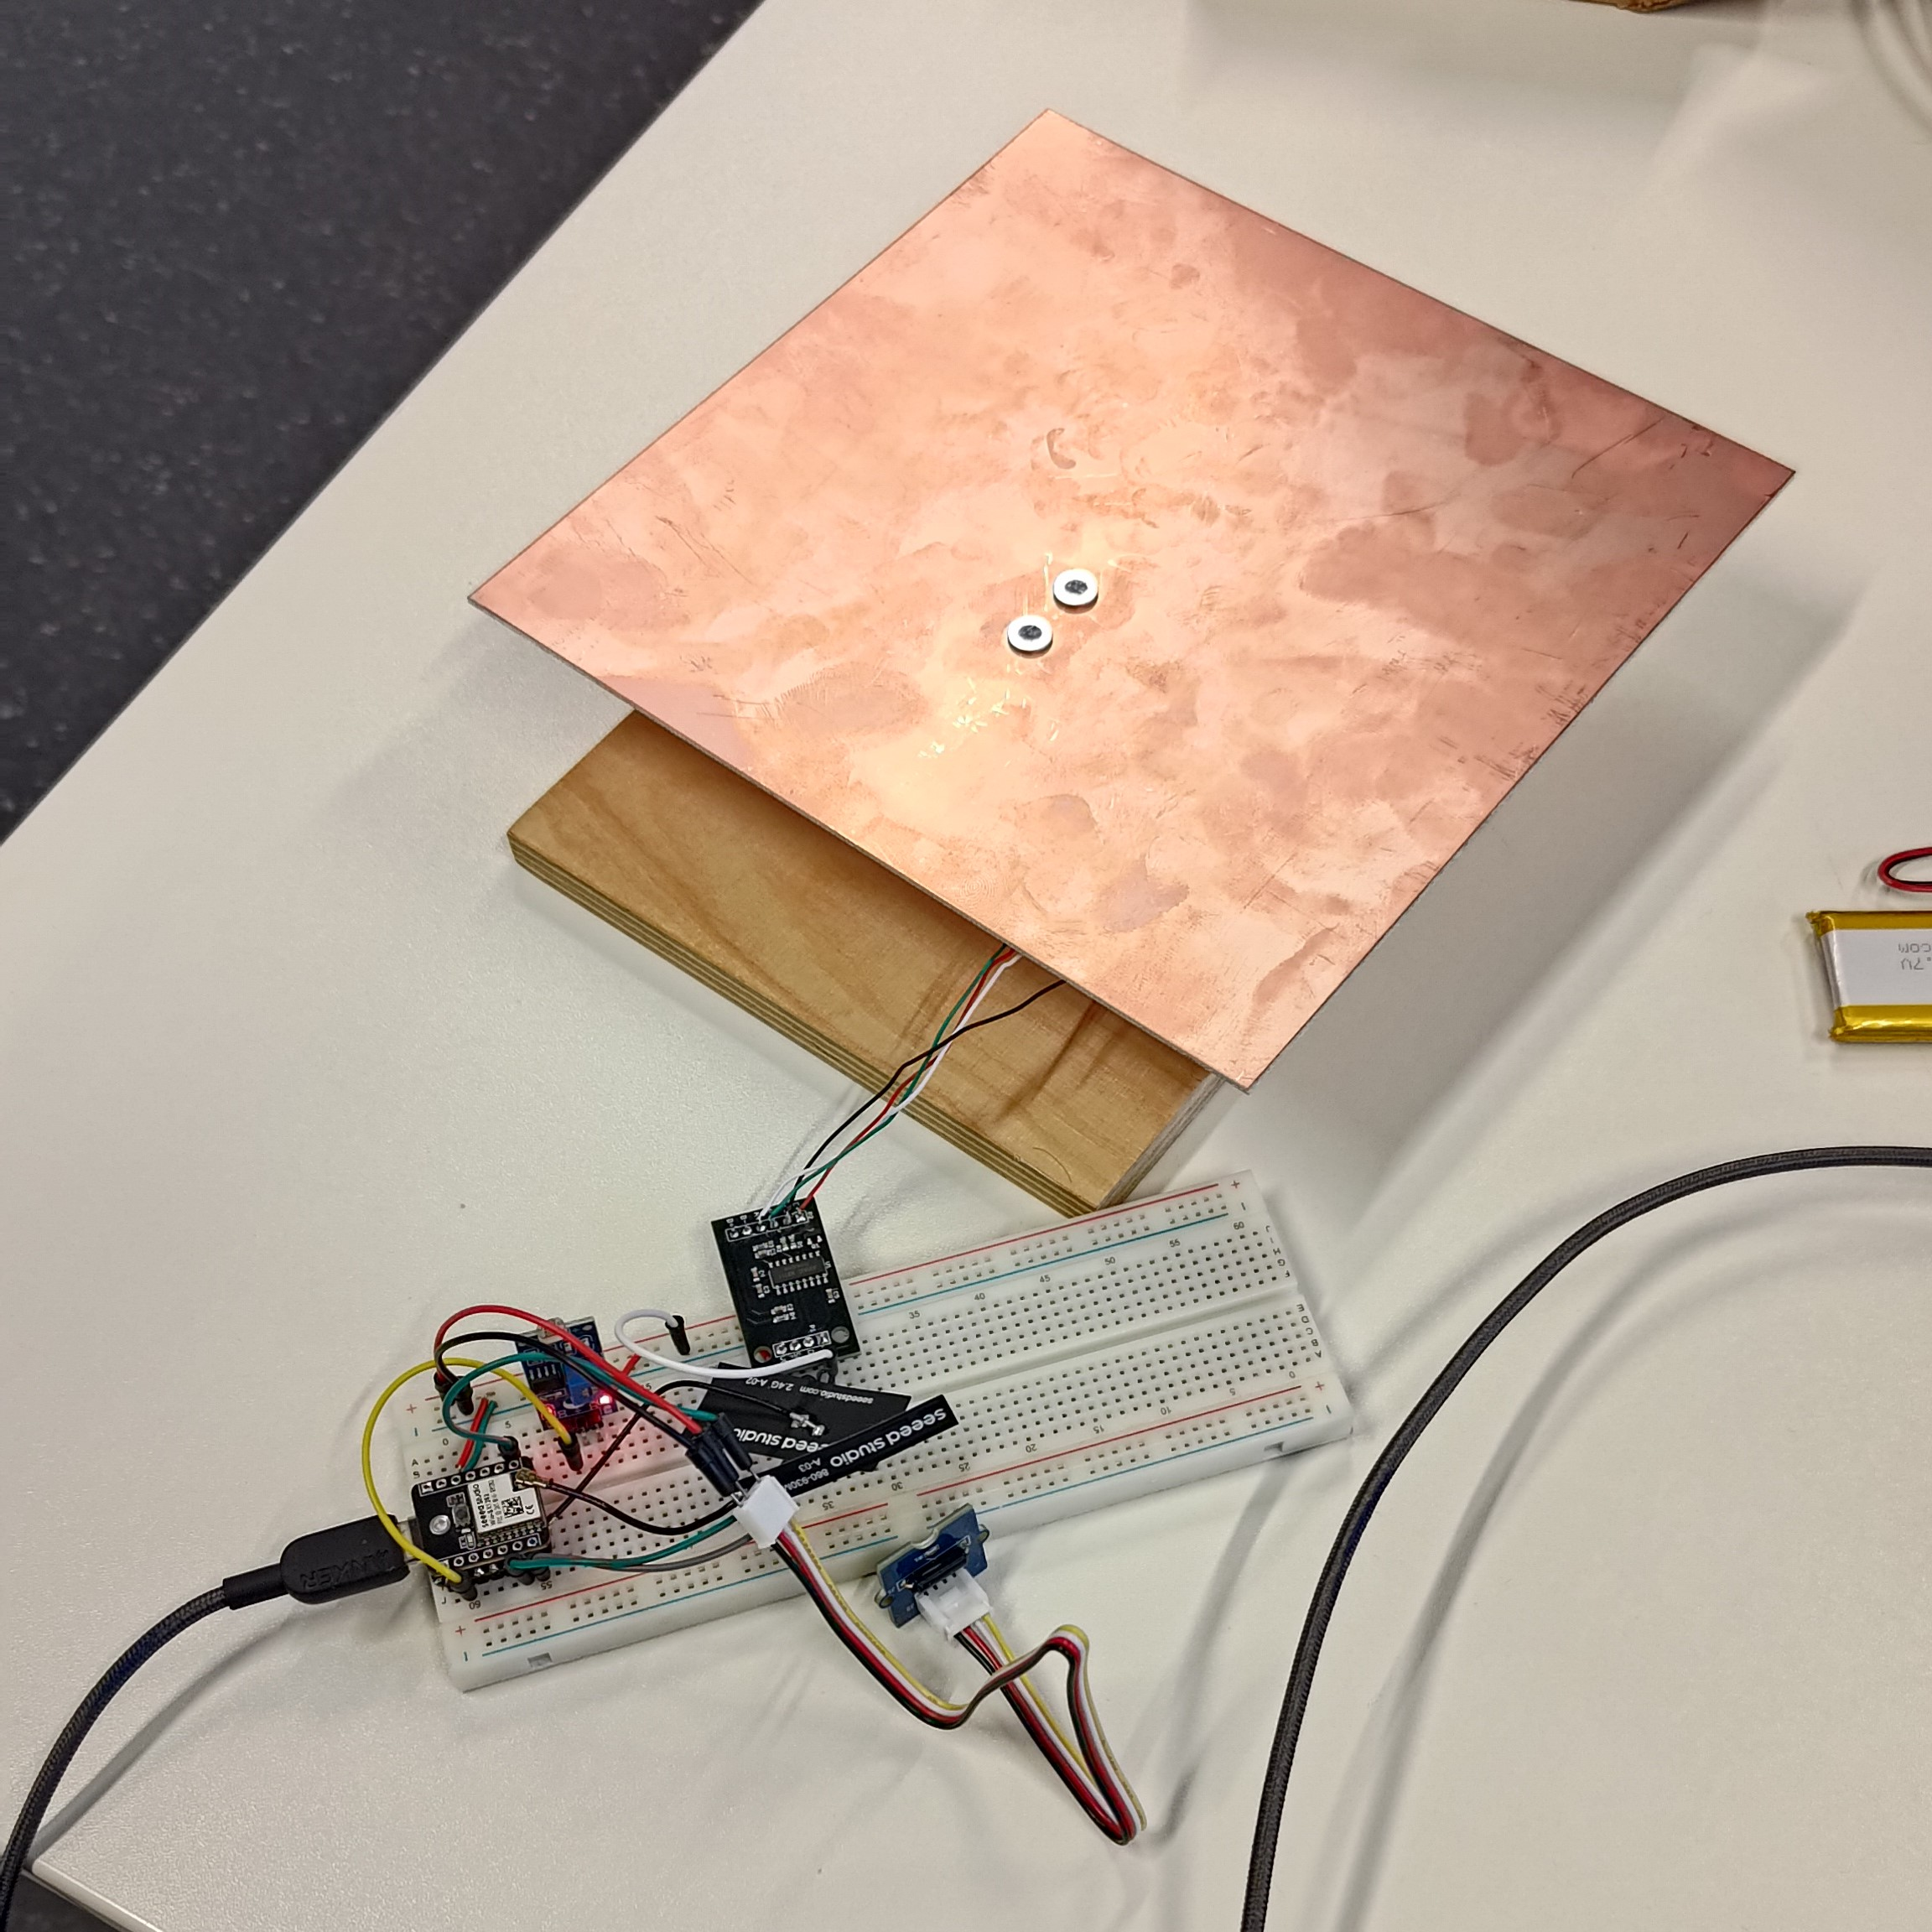
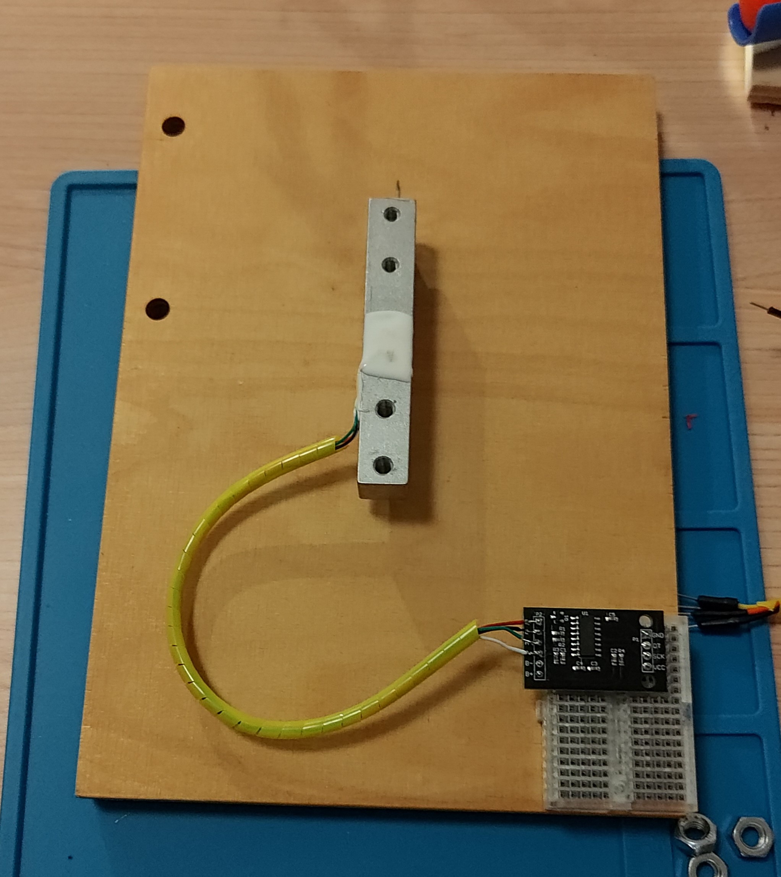
Sensor Interfacing
Notes:
We started with sensor interfacing.
Given that the LDR and tilt sensors were both digital sensors, the actual connections were rather straight forward
The only complications were with the HX711 which needed calibration

Slide 12
Sensor Interfacing
First Prototype
Notes:
We started with sensor interfacing.
Given that the LDR and tilt sensors were both digital sensors, the actual connections were rather straight forward
The only complications were with the HX711 which needed calibration

Slide 13


Sensor Interfacing
Load Cell Calibration
Notes:
We started with sensor interfacing.
Given that the LDR and tilt sensors were both digital sensors, the actual connections were rather straight forward
The only complications were with the HX711 which needed calibration – we essentially just weighed and object with a scale and then placed the same object onto the load cell. The reading we got then allowed us to find the scaling factor by simply dividing the reading by the weight. We did this a few times and averaged the values to get the scaling factor we used in the code.

Slide 14
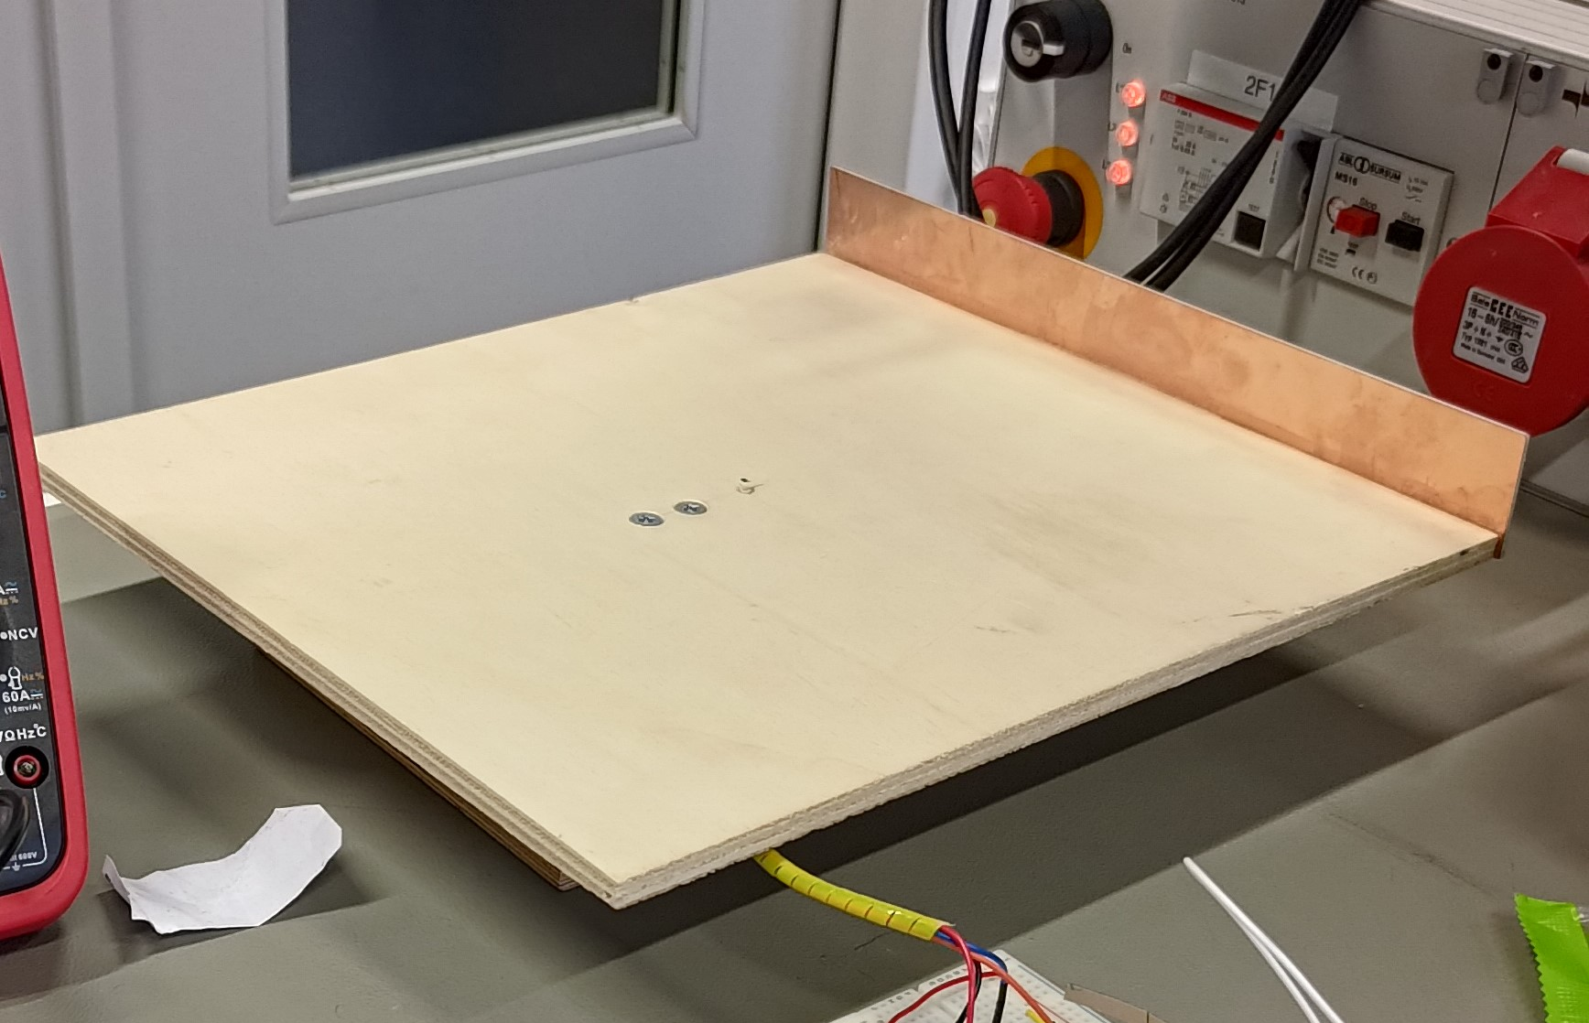
Sensor Interfacing
Tare Issue
Notes:
We started with sensor interfacing.
Given that the LDR and tilt sensors were both digital sensors, the actual connections were rather straight forward
The only complications were with the HX711 which needed calibration – we essentially just weighed and object with a scale and then placed the same object onto the load cell. The reading we got then allowed us to find the scaling factor by simply dividing the reading by the weight. We did this a few times and averaged the values to get the scaling factor we used in the code.

Slide 15
Sensor Interfacing
Housing Improvements
Notes:
We started with sensor interfacing.
Given that the LDR and tilt sensors were both digital sensors, the actual connections were rather straight forward
The only complications were with the HX711 which needed calibration – we essentially just weighed and object with a scale and then placed the same object onto the load cell. The reading we got then allowed us to find the scaling factor by simply dividing the reading by the weight. We did this a few times and averaged the values to get the scaling factor we used in the code.
We improved the housing ny making the top platform bigger and securing the HX711 to the base as we had an incident where the wires came loose

Slide 16




LoRaWAN
Website/Mail
Application Layer
ESP32 + SW1262
LoRa Antenna
Legend Communication
Wired LoRaWAN Internal server

Slide 17


LoRaWAN
Website/Mail
Application Layer
ESP32 + SW1262
LoRa Antenna
LoRaWAN Gateway
Legend Communication
Wired LoRaWAN Internal server
Internet

Slide 18

LoRaWAN
Website/Mail
RadioLib
Application Layer
ESP32 + SW1262
LoRa Antenna
LoRaWAN Gateway
Legend Communication
Wired LoRaWAN Internal server
Internet

Slide 19

LoRaWAN
Re-Joining Issue
Website/Mail
RadioLib
Application Layer
ESP32 + SW1262
LoRa Antenna
LoRaWAN Gateway
Legend Communication
Wired LoRaWAN Internal server
Internet

Slide 20

LoRaWAN
Re-Joining Issue
Website/Mail
RadioLib
Application Layer
ESP32 + SW1262
LoRa Antenna
LoRaWAN Gateway
Legend Communication
Wired LoRaWAN Internal server
Internet
NVM

Slide 21
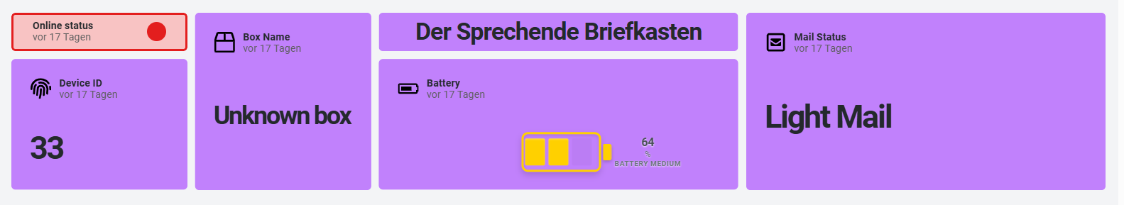
Application Layer
Decoding the Payload
Mapping Device ID to Specific User Email
Providing User Interface
Device ID
Mail Status
Battery ID
Battery Status
Device ID
User Email

Slide 22
Application Layer
Device ID
Mail Status
Decoding the Payload
Mapping Device ID to Specific User Email
Providing User Interface
Battery ID
Battery Status
Device ID
User Email

Slide 23
Application Layer
Device ID
Mail Status
Battery ID
Battery Status
Device ID
Decoding the Payload
Mapping Device ID to Specific User Email
Providing User Interface
User Email

Slide 24
Application Layer
Device ID
Device ID
Mail Status
Battery ID
User Email
Battery Status
Decoding the Payload
Mapping Device ID to Specific User Email
Providing User Interface

Slide 25

Results
Demonstration

Slide 26
Demonstration

Slide 27

Potential Improvements
Possible future work and improvments

Slide 28
Ideas for the Future
Improved housing design: Integrate electronics directly into the load-cell platform for better protection and fit.
Local server deployment: Host the backend on a Raspberry Pi for local access and greater control.
Audible tamper alert: Add a buzzer to alert nearby users when tampering is detected.
Energy harvesting: Use a piezo element in the lid to generate power during opening/closing.
Multi-mailbox support: Expand the system to monitor multiple mailboxes using device IDs and multiplexers.

Slide 29
Conclusion

Slide 30
Thank You
Any questions?

Slide 31
References
Fouvin. (2025). Mailbox sensor with remote monitoring via tuya app. Amazon. Re-trieved from https://www.amazon.de/Bewegungssensor-Intelligenter-Bewegungsmelder-Heimsicherheit-Fern%C3%BCberwachungs/dp/B0DDGGDMPX/ (Accessed: 2025-12-29)
InstaView. (2024). Long-range mail arrival indicator device. Amazon. Retrieved from https://www.amazon.com/InstaView-Delivered-Notification-Long-range-Indicator/dp/B0DPDRX6MG(Accessed: 2025-12-29)
Notific. (2025). Smart mailbox sensor. Notific.at. Retrieved from https://notific.at/en (Accessed:2025-12-29)
X-Sense. (2025). Smart briefkastensensor sma51. Bigshopper. Retrieved from https://bigshopper.de/product/x-sense-smart-briefkastensensor-erfordert-sbs50-basisstation-funk-melder-mit-grosser-reichweite-fuer-briefkaesten-briefkasten-alarm-zugestellte-post-sma51-2941520710.htm? (Accessed: 2025-12-29)

Slide 32
Attribution Links
Some icons were used from flaticons, here are the attribution links:
https://www.flaticon.com/free-icons/light-dependent-resistor : Light dependent resistor icons created by verluk – Flaticon
https://www.flaticon.com/free-icons/antenna : Antenna icons created by Freepik – Flaticon
https://www.flaticon.com/free-icons/spirit-level : Spirit level icons created by juicy_fish - Flaticon

Slide 33
Functional Requirements
For The Talking Door to be a satisfiable product, the following functional requirements must be implemented:
It can detect whether or not mail is present within the mailbox
It can detect if the mailbox is opened
It can check the battery status
It can communicate if a mail is in the box to a website (based on LoRaWAN)
It can detect light as a redundancy for confirming the opening status of the mailbox
It alerts the responsible person via email or dashboard upon mail detection
It sends battery status updates to a website every hour
It sends a low battery warning to a website when the battery falls below a defined threshold

Slide 34
Technical Requirements
For The Talking Door to operate and perform its functions, the following technical requirements must be implemented:
The weight sensor can detect a change in weight of approximately 20g. This indicates when a piece of mail has been placed within the box
The tilt sensor can detect the rotation of the post box lid. This indicates when the lid is opened.
The LDR can detect the change in light intensity by a defined threshold. This indicates when the lid is opened.
The transmitter can reliably connect and communicate via the LoRaWAN Gateway.
The server with which the LoRaWAN communicates, can send emails to relevant personnel about the mail.
The power supply is a battery with a working voltage of 3.1V to 5.5V
The enclosure can protect the system within a typical indoor environment (IP 31)
The system should function at temperatures ranging 0-40°C and humidity 10-90%

Slide 35
Price Estimates
Component | Price Estimate [EUR]
Weight Sensor | 8.00
Digital Tilt Sensor | 3.00
ESP 32 + LoRa Module + Antenna | 15.00
LDR | 1.00
Battery | 9.00
Housing estimate (extreme case) | 20.00
Total | 55

Slide 36


Solution: The Talking Mailbox
Check post
Your mailbox knows when something arrives
Weight sensor to detect post in box
Same sensor can detect when post is removed
Notify
The mailbox talks to you
Update a website to see if post is in the box
Optional: mail the respective person
Alert
Stay alert
Monitors battery and alerts user in case of low battery
Detects opening, and alerts user: avoid tampering

Slide 37
Solution: The Talking Mailbox
Check post
Your mailbox knows when something arrives
Weight sensor to detect post in box
Same sensor can detect when post is removed
Notify
The mailbox talks to you
Update a website to see if post is in the box
Optional: mail the respective person
Alert
Stay alert
Monitors battery and alerts user in case of low battery
Detects opening, and alerts user: avoid tampering

Slide 38

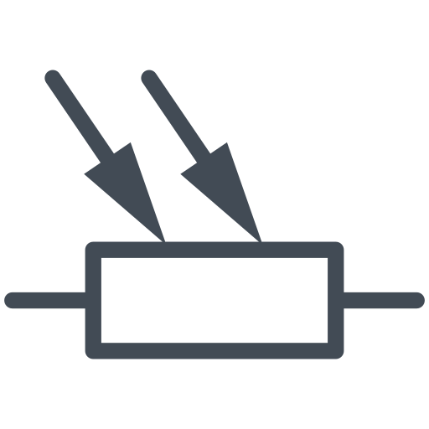

Product technologies and interaction
Weight
Sensor
Website/Mail
LDR
WiFi LoRa ESP32
LoRa Antenna
Backend Layer
Legend Communication
Wired LoRaWAN Internal server
Tilt Sensor

Slide 39
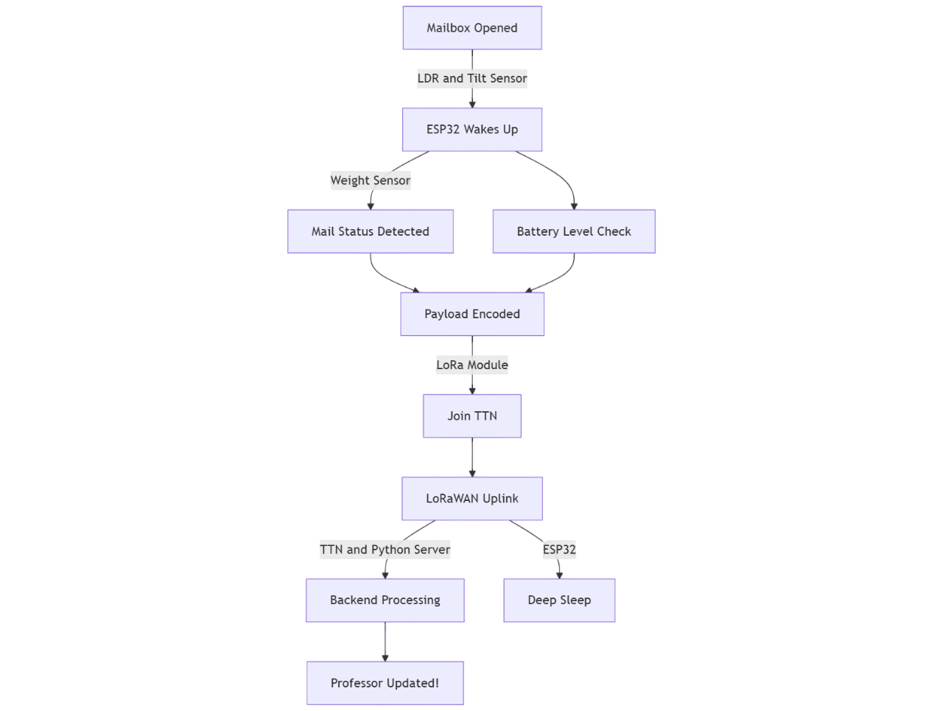
Our Approach
Detect
opening
Mail Status Detection
A combination of Light and Tilt Sensors to detect opening
Use a weight sensor to detect presence if mail and classify amount
Notify personnel
Monitor
battery
Detecting post triggers LoRaWAN gateway notification (website/mail)
Check voltage levels, in case it drops below a threshold, alert the user
Notes:
Use a weight sensor to detect if a post comes in

